Slide 1

E-Library Management System
Presented by:-
Devansh Kopra – 21107013
Khushi Kadam – 21107031
Shravani Kulkarni – 21107063
Krish Jaswal - 21107039
Project Guide -
Prof. Vaibhav Yavalkar

Slide 2
Introduction :
Library management system , also called an AUTOMATED LIBRARY SYSTEM
Defined as a software that has been established to manage basic housekeeping function of a library
LMS helps to provide information on any book present in the library to the user as well as the staff of any Institution
Also helps to keep a track of book published , Given in return and added to the library

Slide 3
Solution Proposed :
Library Management System software reduces the need for manpower and stationary , which leads to lower operational costs
The system also saves time for both , the user and the Librarian

Slide 4
Objectives :
Fast communication with electronic and computerized service
Users can see the latest edition of the library stock
Reduce theft of books
Reduces the duplication of work
Online facility helps in smooth functioning of library functions

Slide 5
Features:
It is Cost Effective
Keep record of complete information of a book like title , author name , publisher name , etc
Simple , clear search interface for all users
Easy Way to enter new books
It is user-friendly software
Easy to maintain database

Slide 6
Scope :
The system is convenient and flexible to be used. It saves their time, efforts, money and resources
Can update, create, and delete the record of Membership as per requirement
Quick Report View like Book Issued / Registered Students etc
Book Stock verification facility
The user information files can be stored in centralized database which can be maintained by the system

Slide 7
Project Outcome :
It is an easy way to enter new books into the System
Using Library Management System , it is easy to maintain database and can be updated periodically and at user’s wish
It also helps to keep record of complete information of a book like title , author name , publisher name , price of any / each book etc
Simple , clear search interface for all users , admins / teachers

Slide 8
Technology Stack :
FRONT END :-
Netbeans IDE 14
Java JDK 17
BACK END :-
MySQL Workbench 8

Slide 9
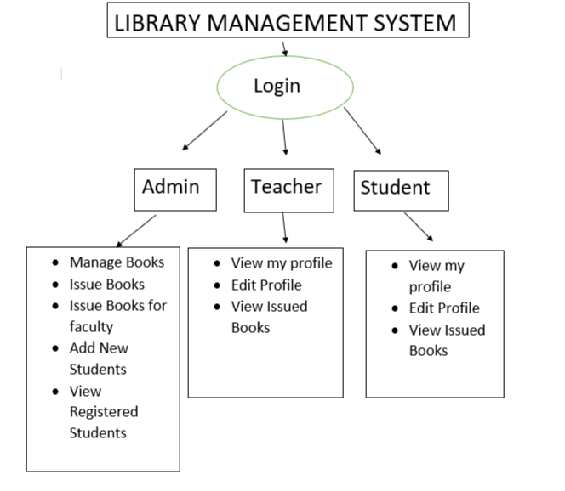
Block Diagram :-

Slide 10
Thank You...!!

